Slide 1
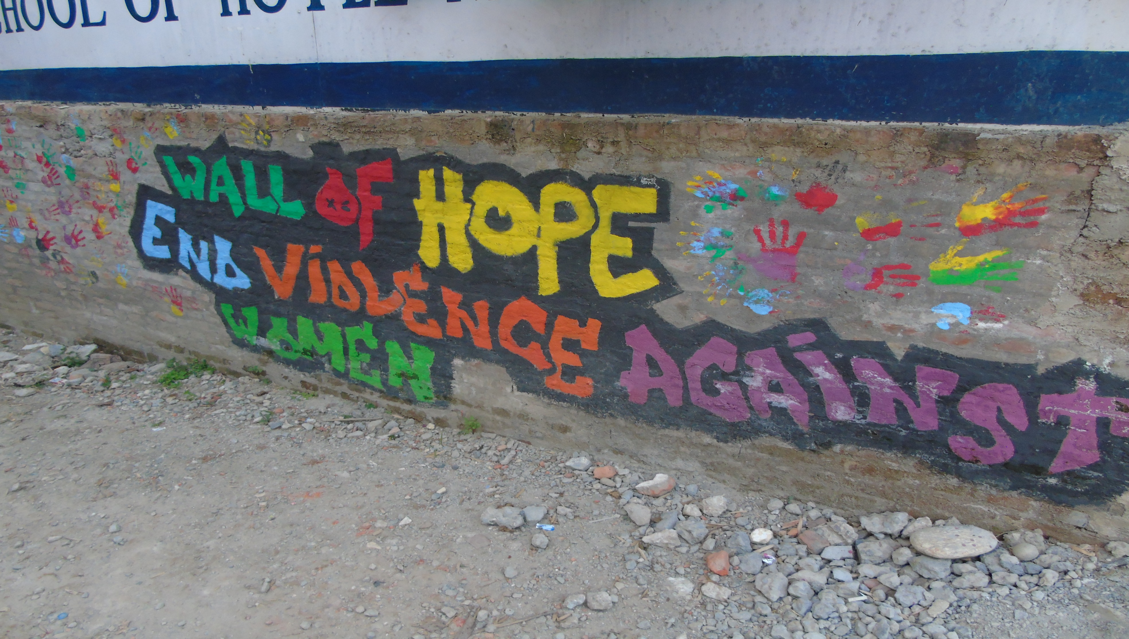
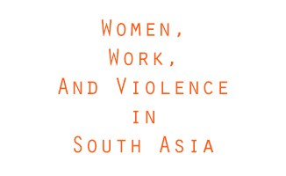
Nepal: Exploring the relationship between women’s income generation and their experiences of violence

Slide 2
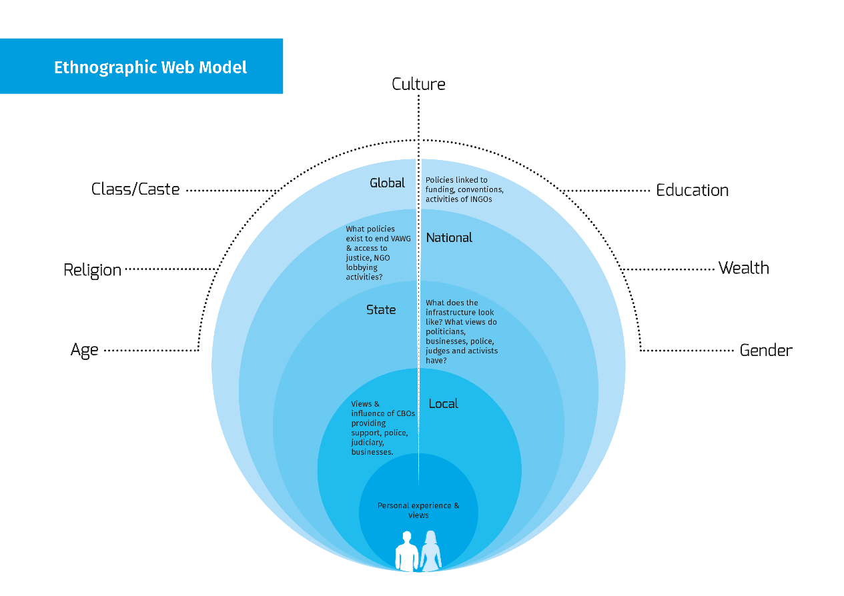

Slide 3
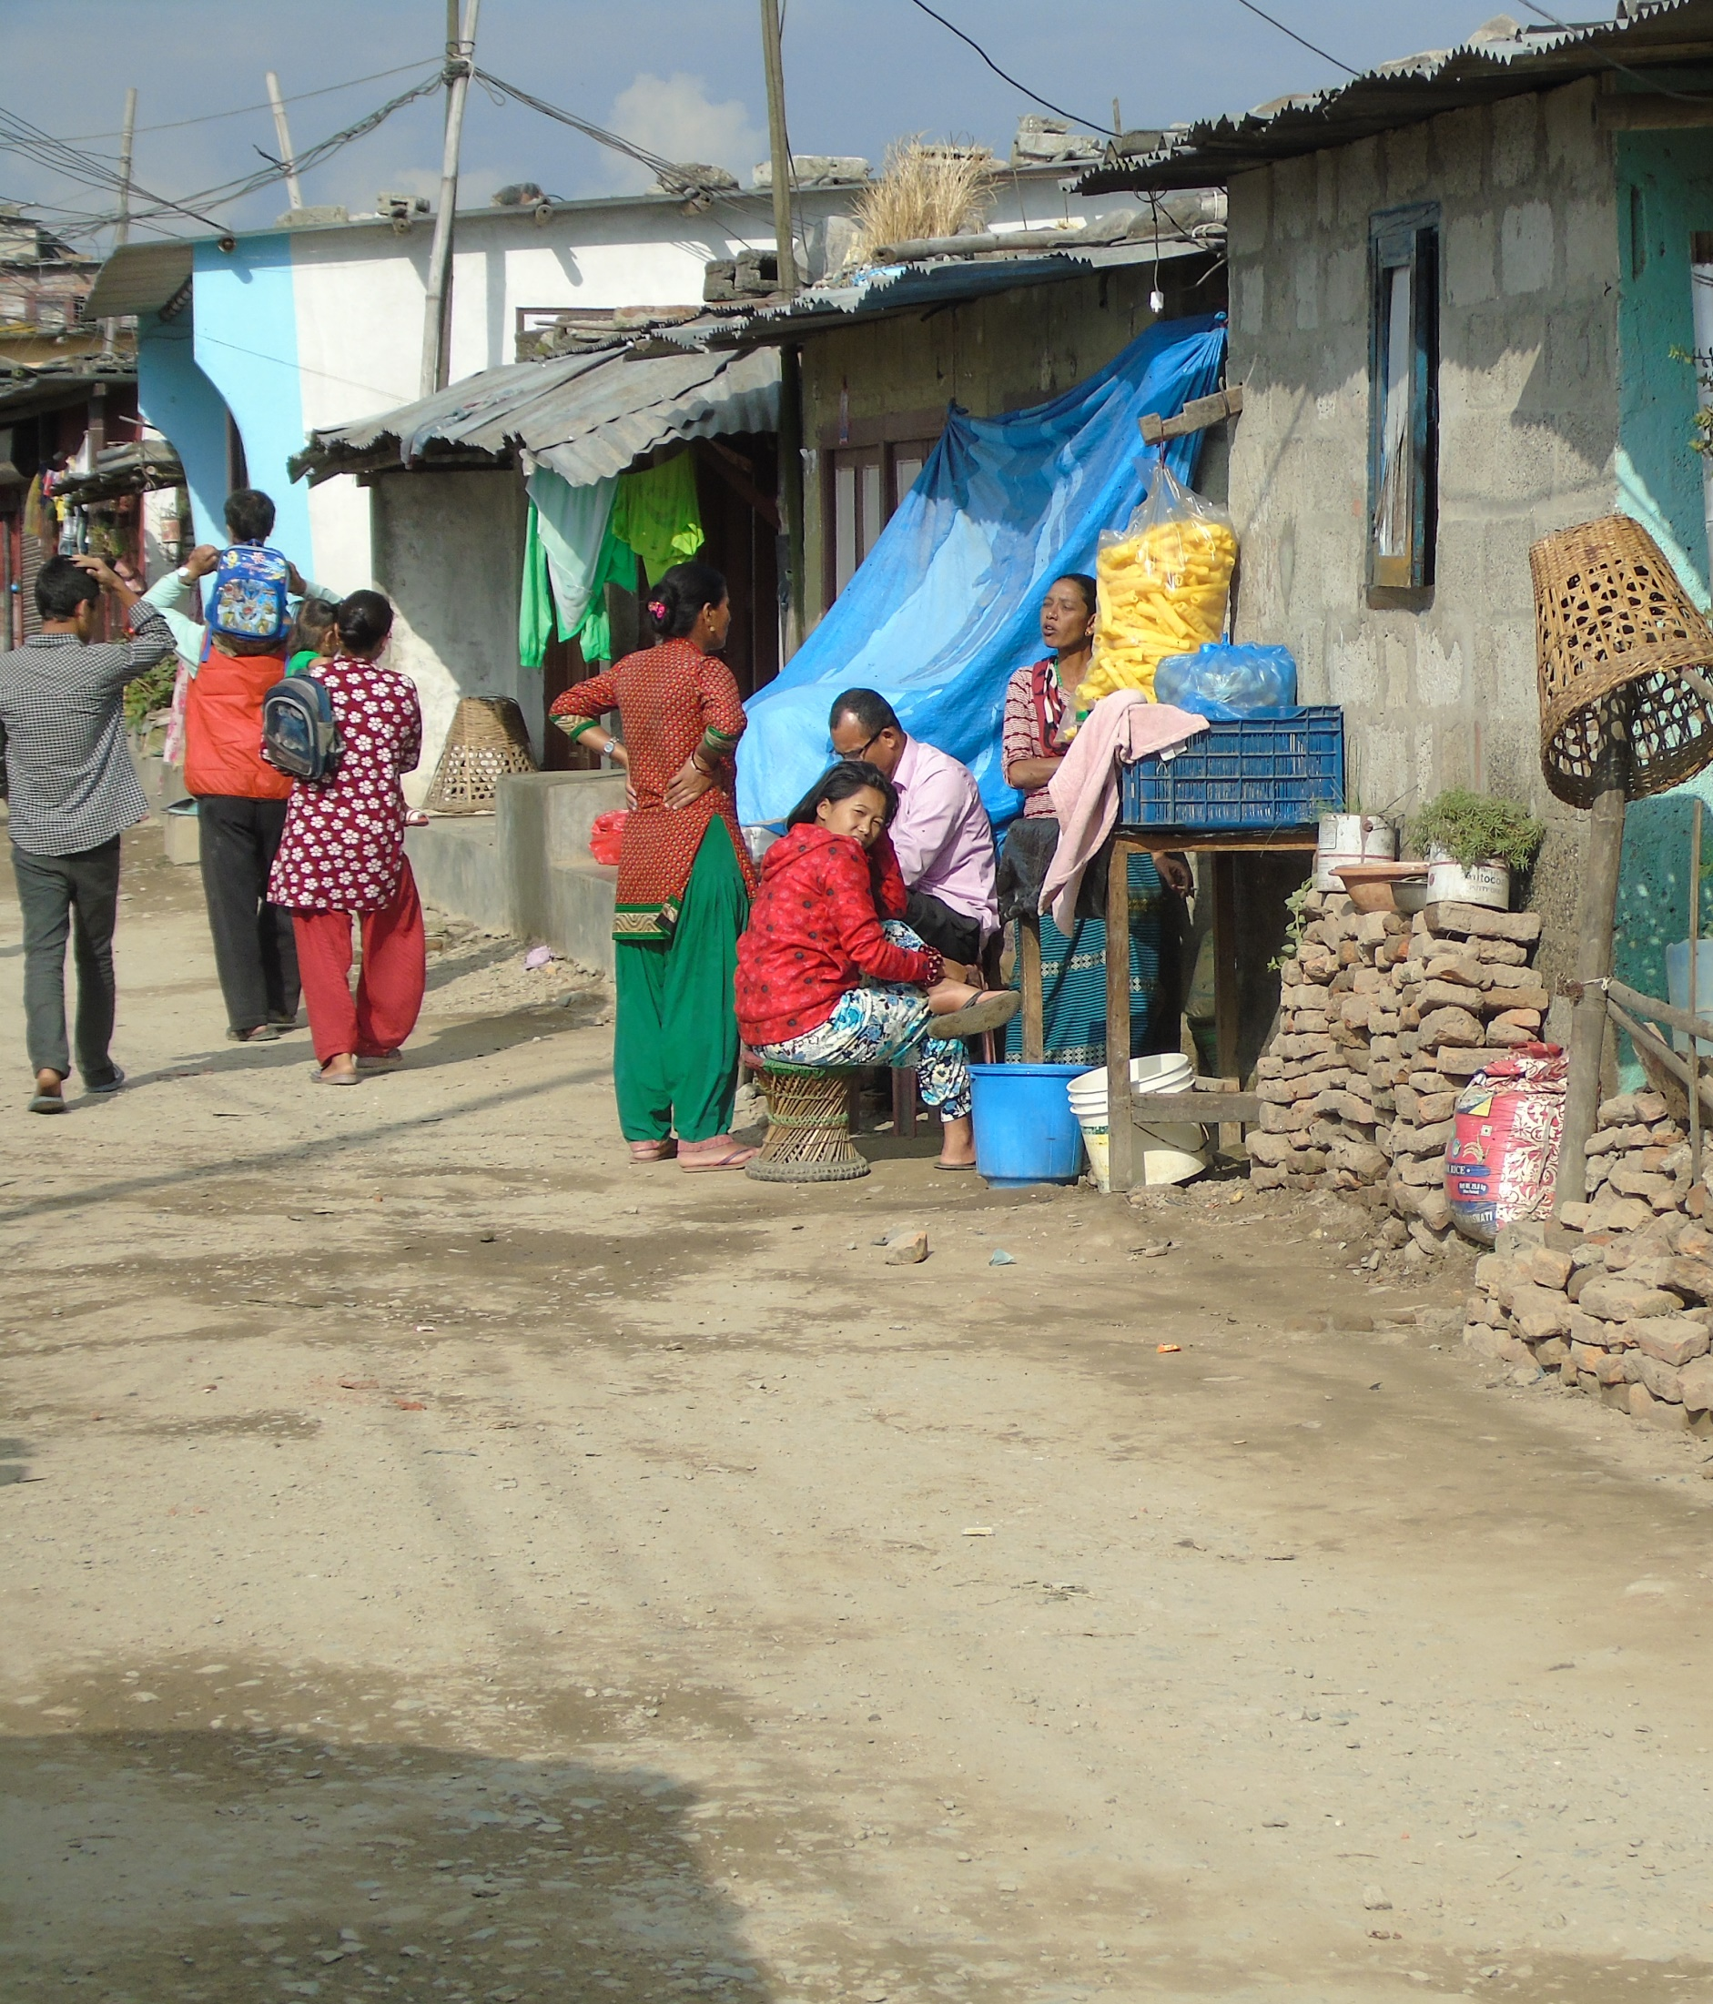
Out from the individual level
Earning an income impacts on relationships within the home
Migration and Family Structures

Slide 4
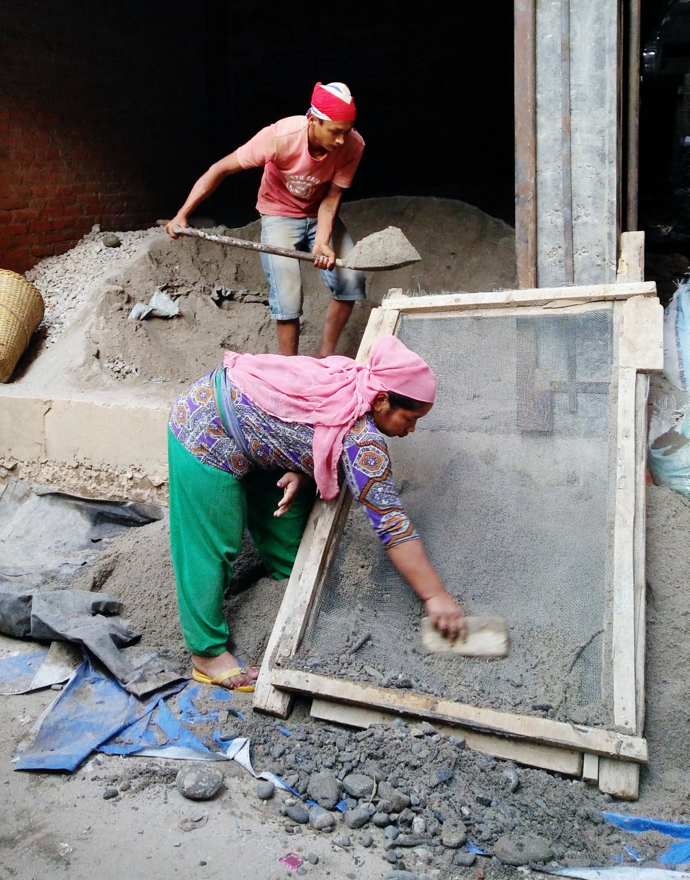
Out from the local level
The nature and conditions of work
“Actually, we [women labourers] are the ones to do the work. It is more difficult than the work they [masons] do; we have to prepare mixture [refers to cement, sand and water], carry bricks and carry sand. They only build the walls still we are paid less. I do not know why.
Maybe because I am a woman. Some are of dominating nature while some are good. If we are working with new contractors then they try to dominate us [labourers]. They think that we should be continuously doing our work. Instead of helping us they try to be the boss and threaten us to bring the materials required.”

Slide 5
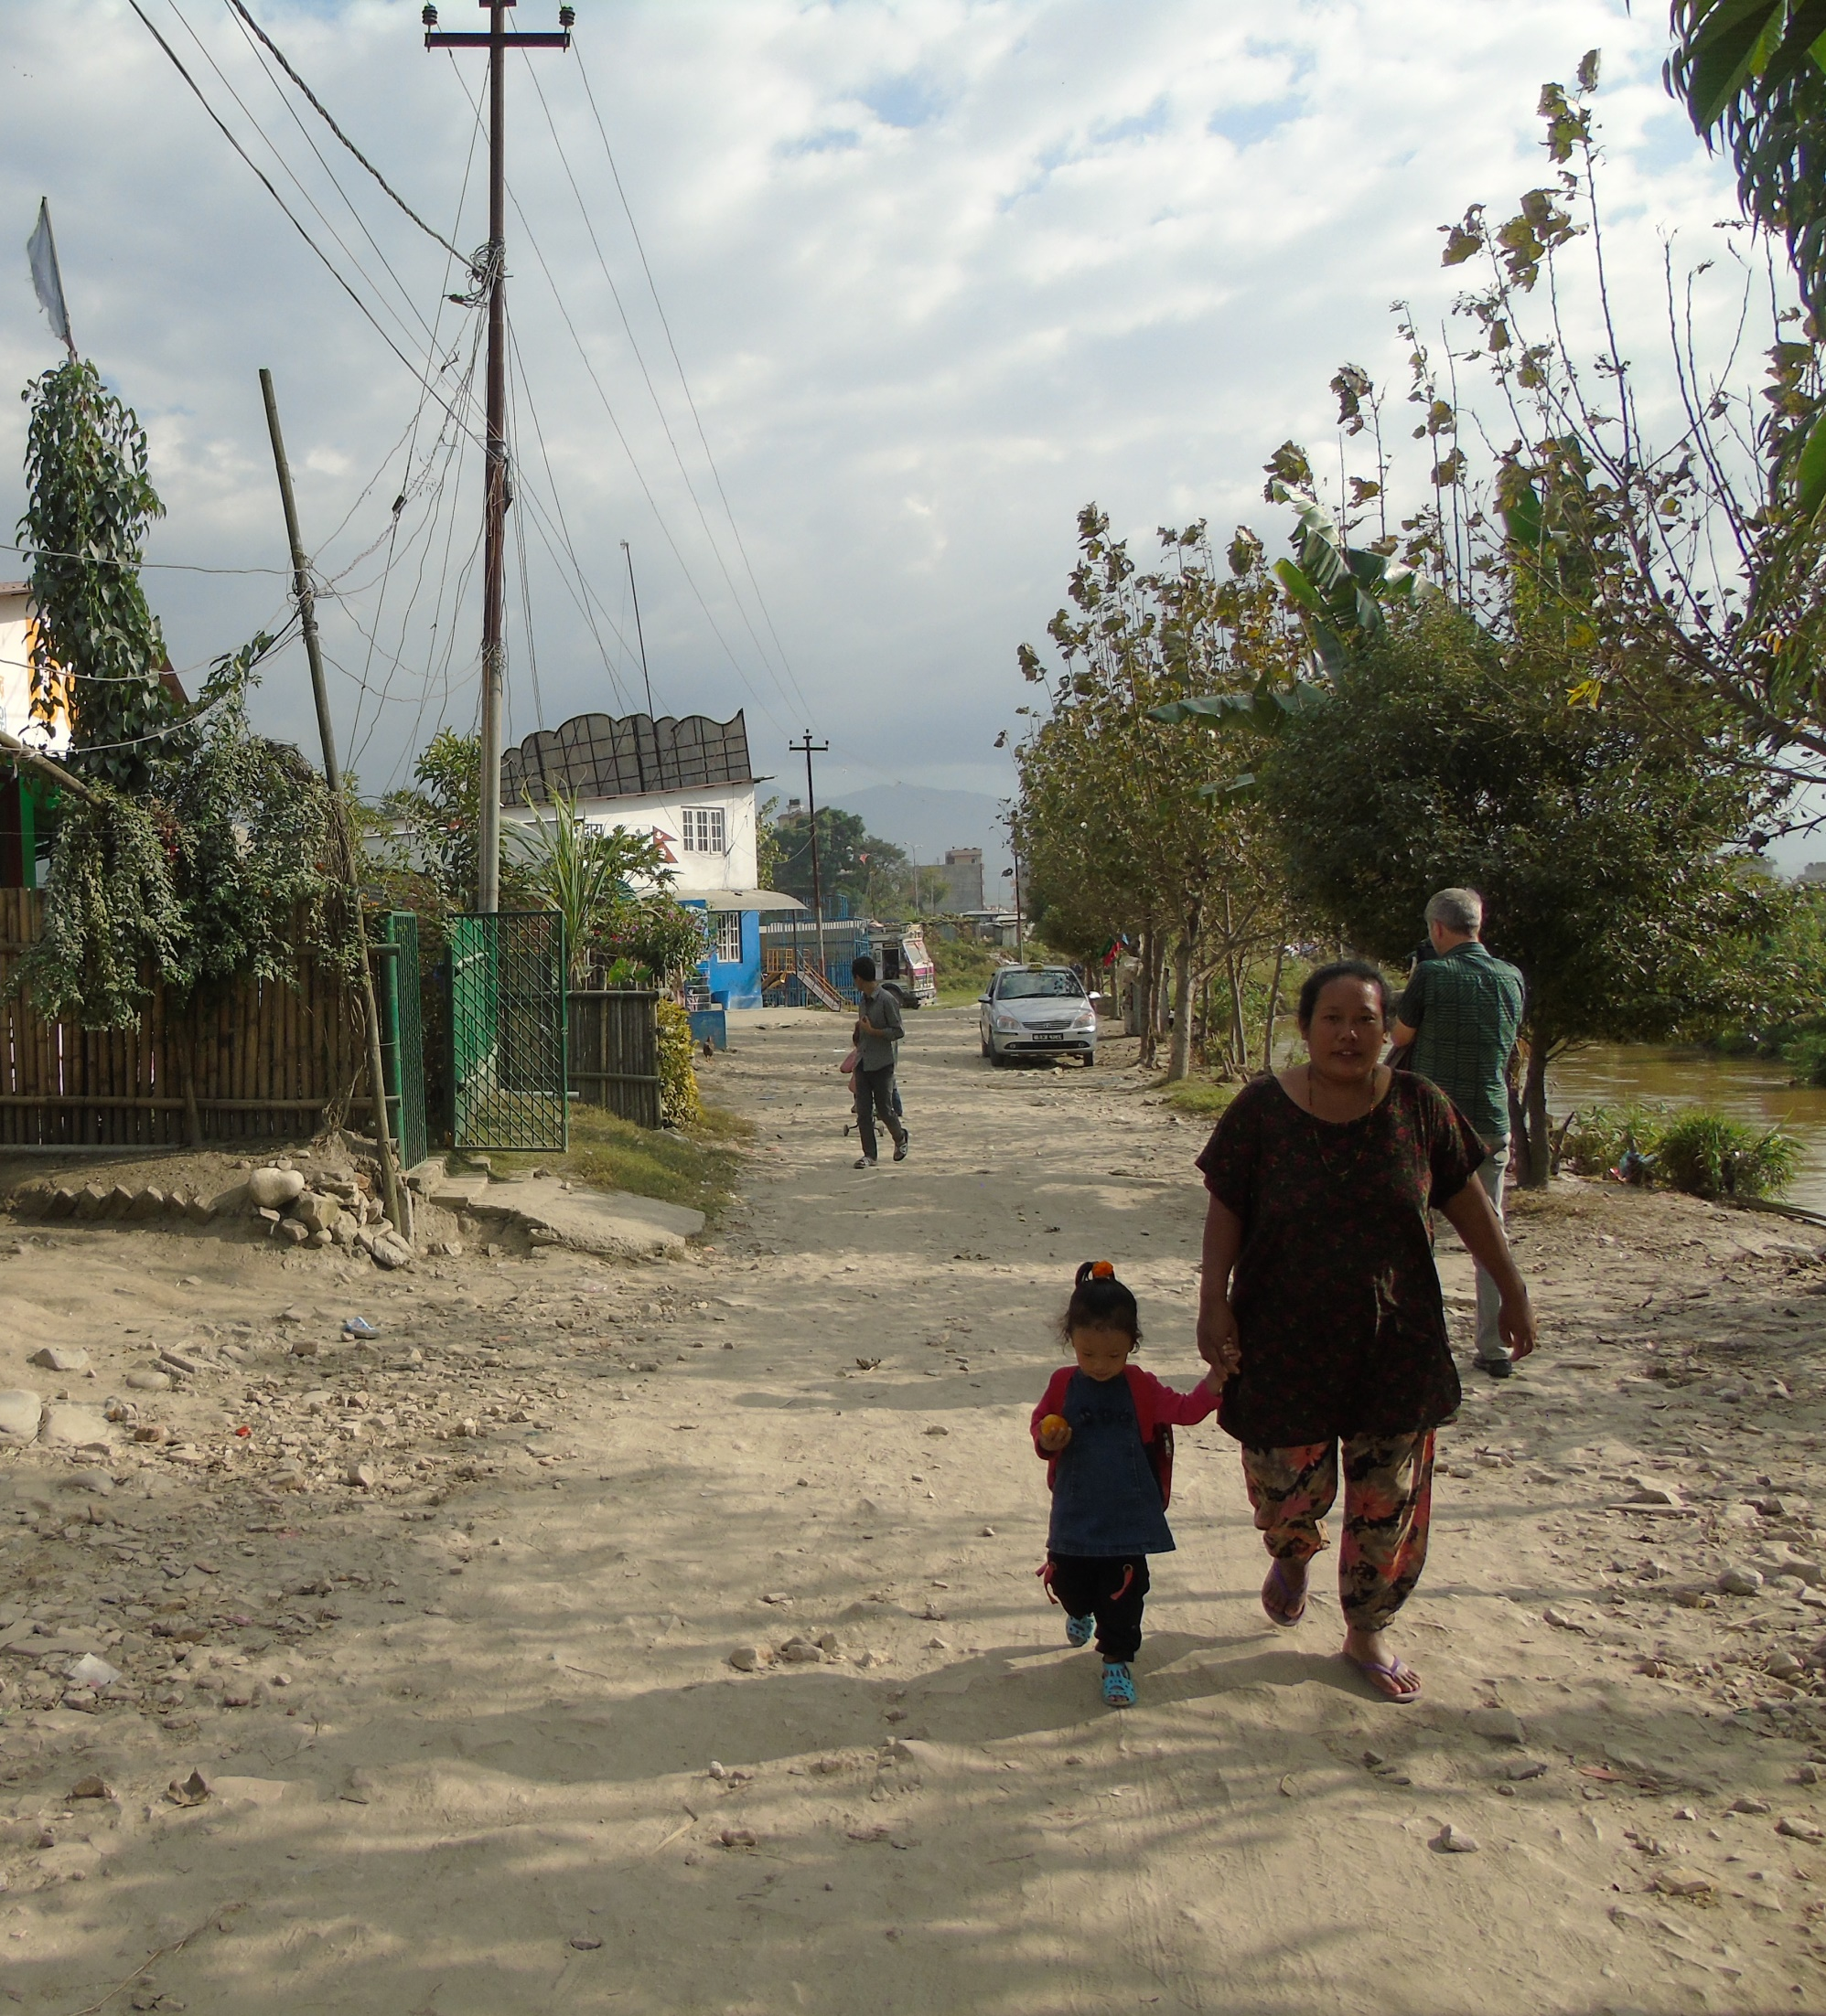
Out from the local level
The nature and type of women’s resilience
“It is very obvious thing that if one earns; others will not say anything but if one doesn’t then others try to dominate you.”

Slide 6
Out from the state level
Rural/Urban differences; findings from the research with the IWDP
Challenging social norms
“I did not do anything like I should leave my husband. I used to rather think that I should die. Once I told about this issue to the social mobilizer of this place, she came and asked him not to repeat such acts in the future but the very next day, he beat me again; he had beaten me in the middle of the road in front of the other people. Then I threatened him that I would file a case against him and get a divorce.”

Slide 7
Intersectional Analysis – Pulling out the Differences

Slide 8
Out from the national level – Recommendations
Promoting local women’s organisation and building capacity at this level to challenge VAW and advocate for survivors is important and should extend to supporting professional women.
Programmes to challenge the gendering of work are crucial and need to target male attitudes specifically.
Work-based harassment policies and procedures need to be reviewed across sectors and evidence of good practice identified and encouraged more strongly.
Women only transport schemes are clearly needed.
VAW sensitive police training is needed.
The role of social mobilisers could be extended and focused more specifically on ending VAW.

