Slide 1
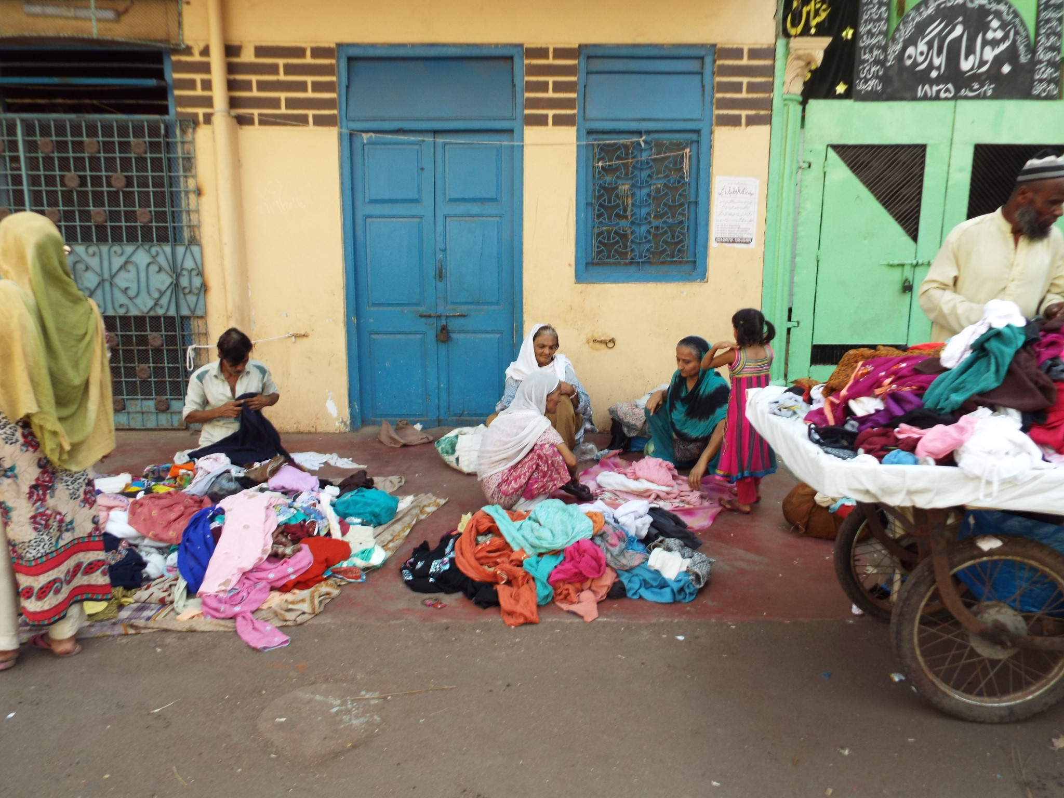
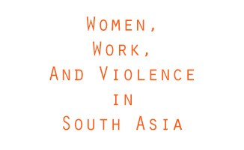
Pakistan: Exploring the relationship between women’s income generation and their experiences of violence

Slide 2
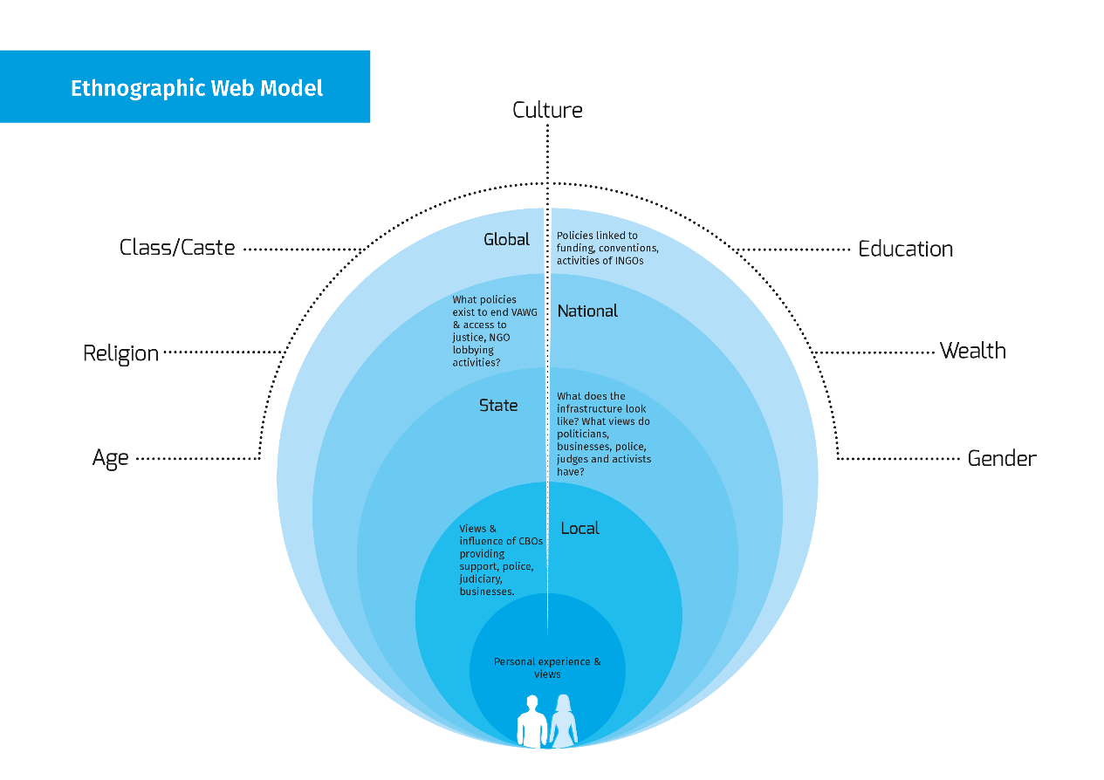

Slide 3
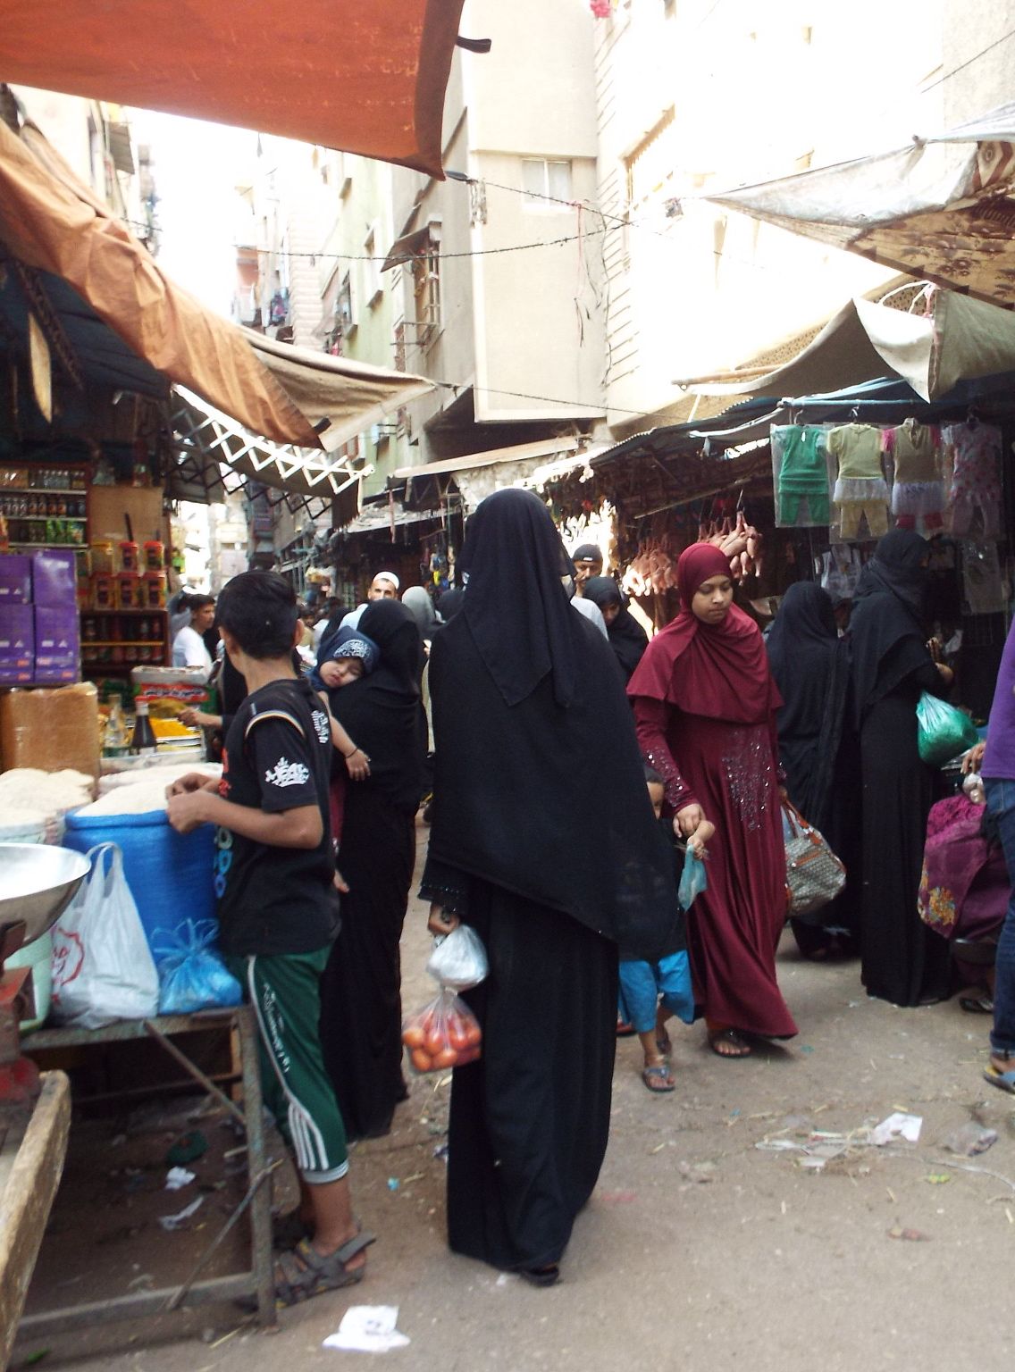
Out from the individual level
Earning an income impacts on relationships within the home
Shakeela was married for many years to a man who was physically and verbally abusive towards her and has one daughter with him. She has worked as a domestic servant for many years and could barely support herself and her daughter with her earnings. While her husband did contribute to the household earnings and did not object to her working outside of the home, he was cruel in various ways.

Slide 4
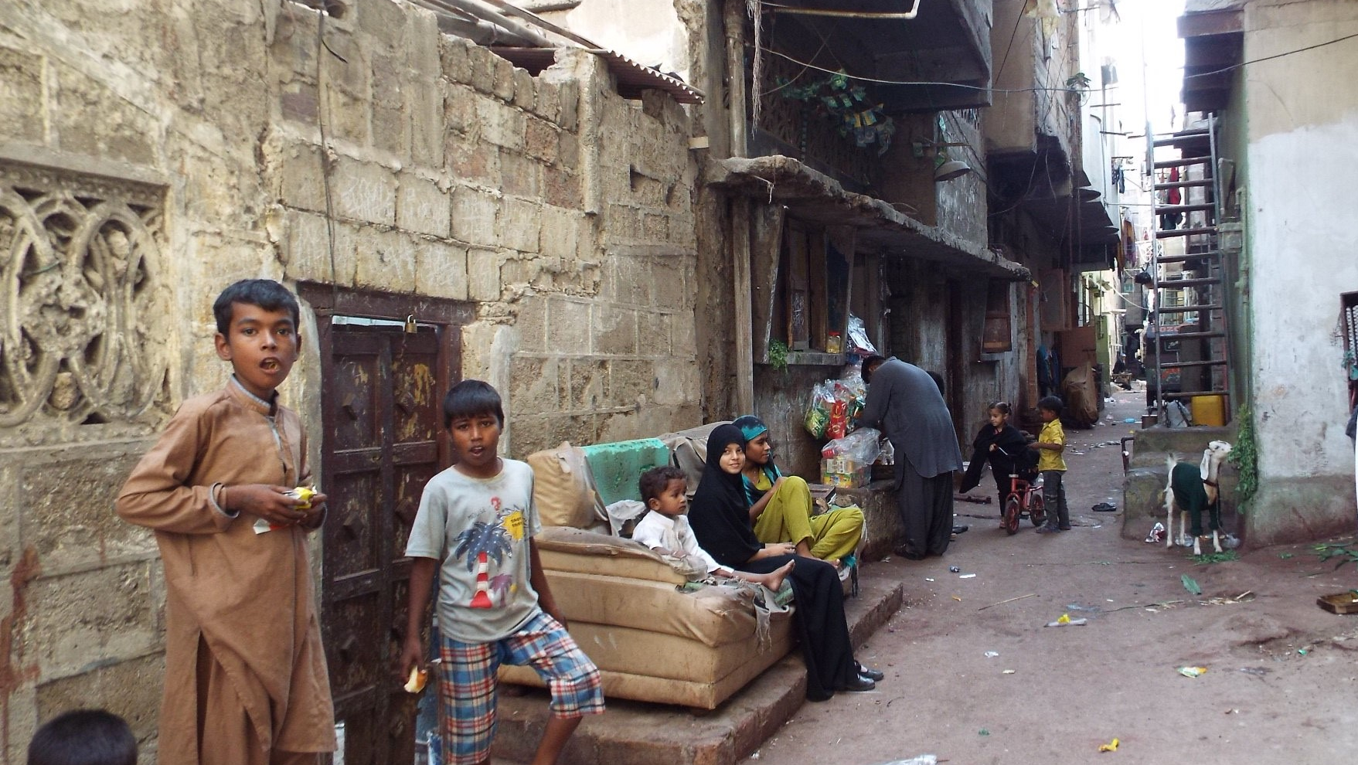
Out from the individual level
Family Structures
Some women argued that their involvement in paid work increased pressures within the household and could contribute to the occurrence of violence.
The husband says to the wife, “you don’t give me time”. Women say to their husbands, “the money you contribute towards household expenses isn’t enough”….This way they both get hot-tempered and this leads to more fights. Then the woman fights with her tongue and the man with his hand.
“Everyone works here, one person’s earnings is not enough to run the house, everything is expensive, wives have to help out by doing embroidery and making paranda (hair accessory).”
“Sister, any home that has hunger in it will have conflict and if there is no hunger there is no conflict.”

Slide 5
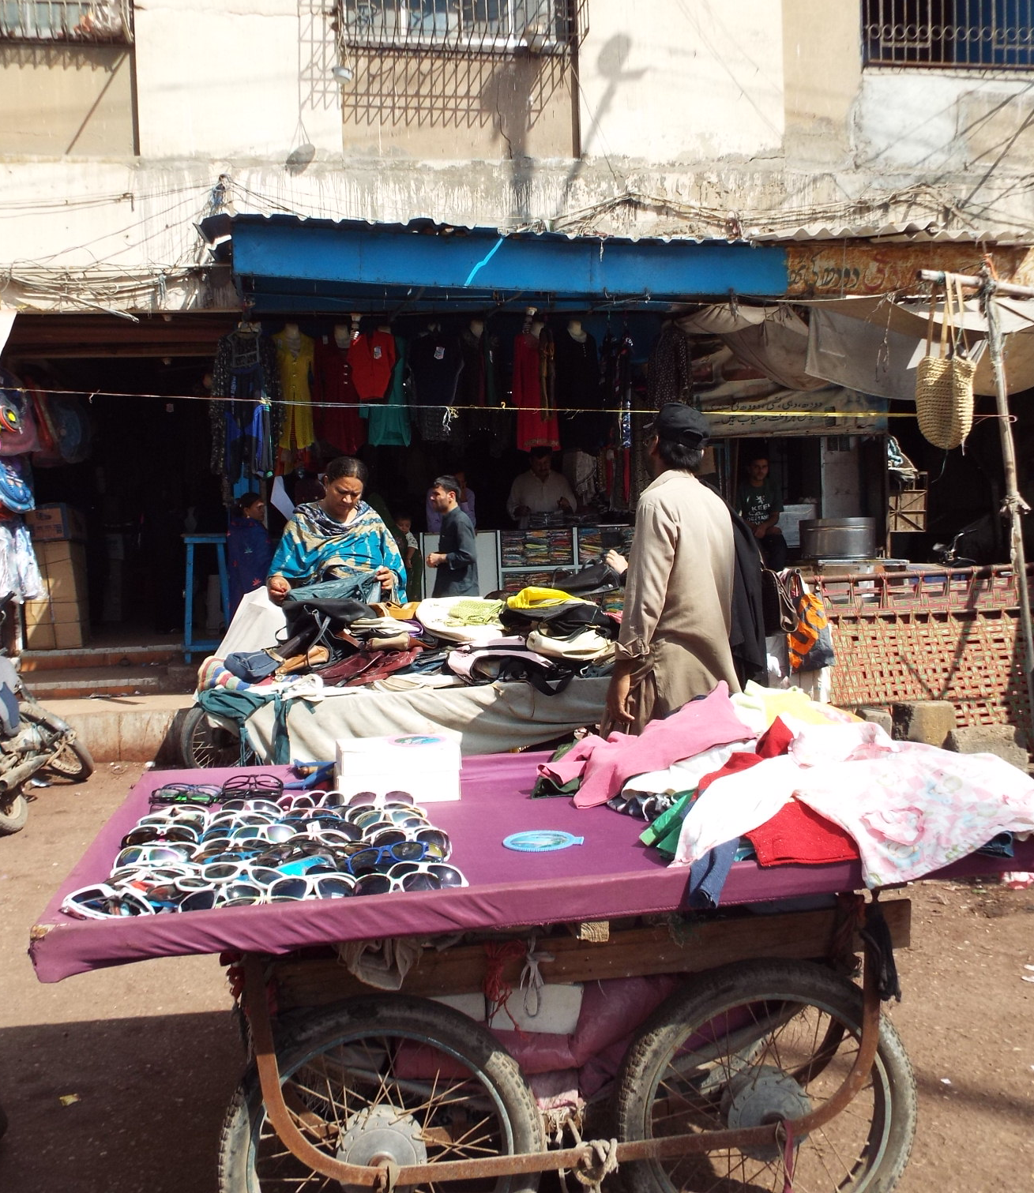
Out from the local level
The nature and conditions of work
Home-Based Workers Network supports women working in very extreme conditions.

Slide 6
Out from the local level
The nature and type of women’s resilience
“One day I downed a bottle of poison when I got tired of my life. When my children were little, if someone said something to my husband (meaning something negative) he would hit me, the fault would lie with someone else but he would take it out on me even though he knew that it was wrong to do this.
Then I tried to take my life. I took rat poison, I was taken to the hospital where they pumped my stomach and saved me. Sometimes I just want to leave the world but then I think about what people will say, they will say she left the world for some guy…”

Slide 7
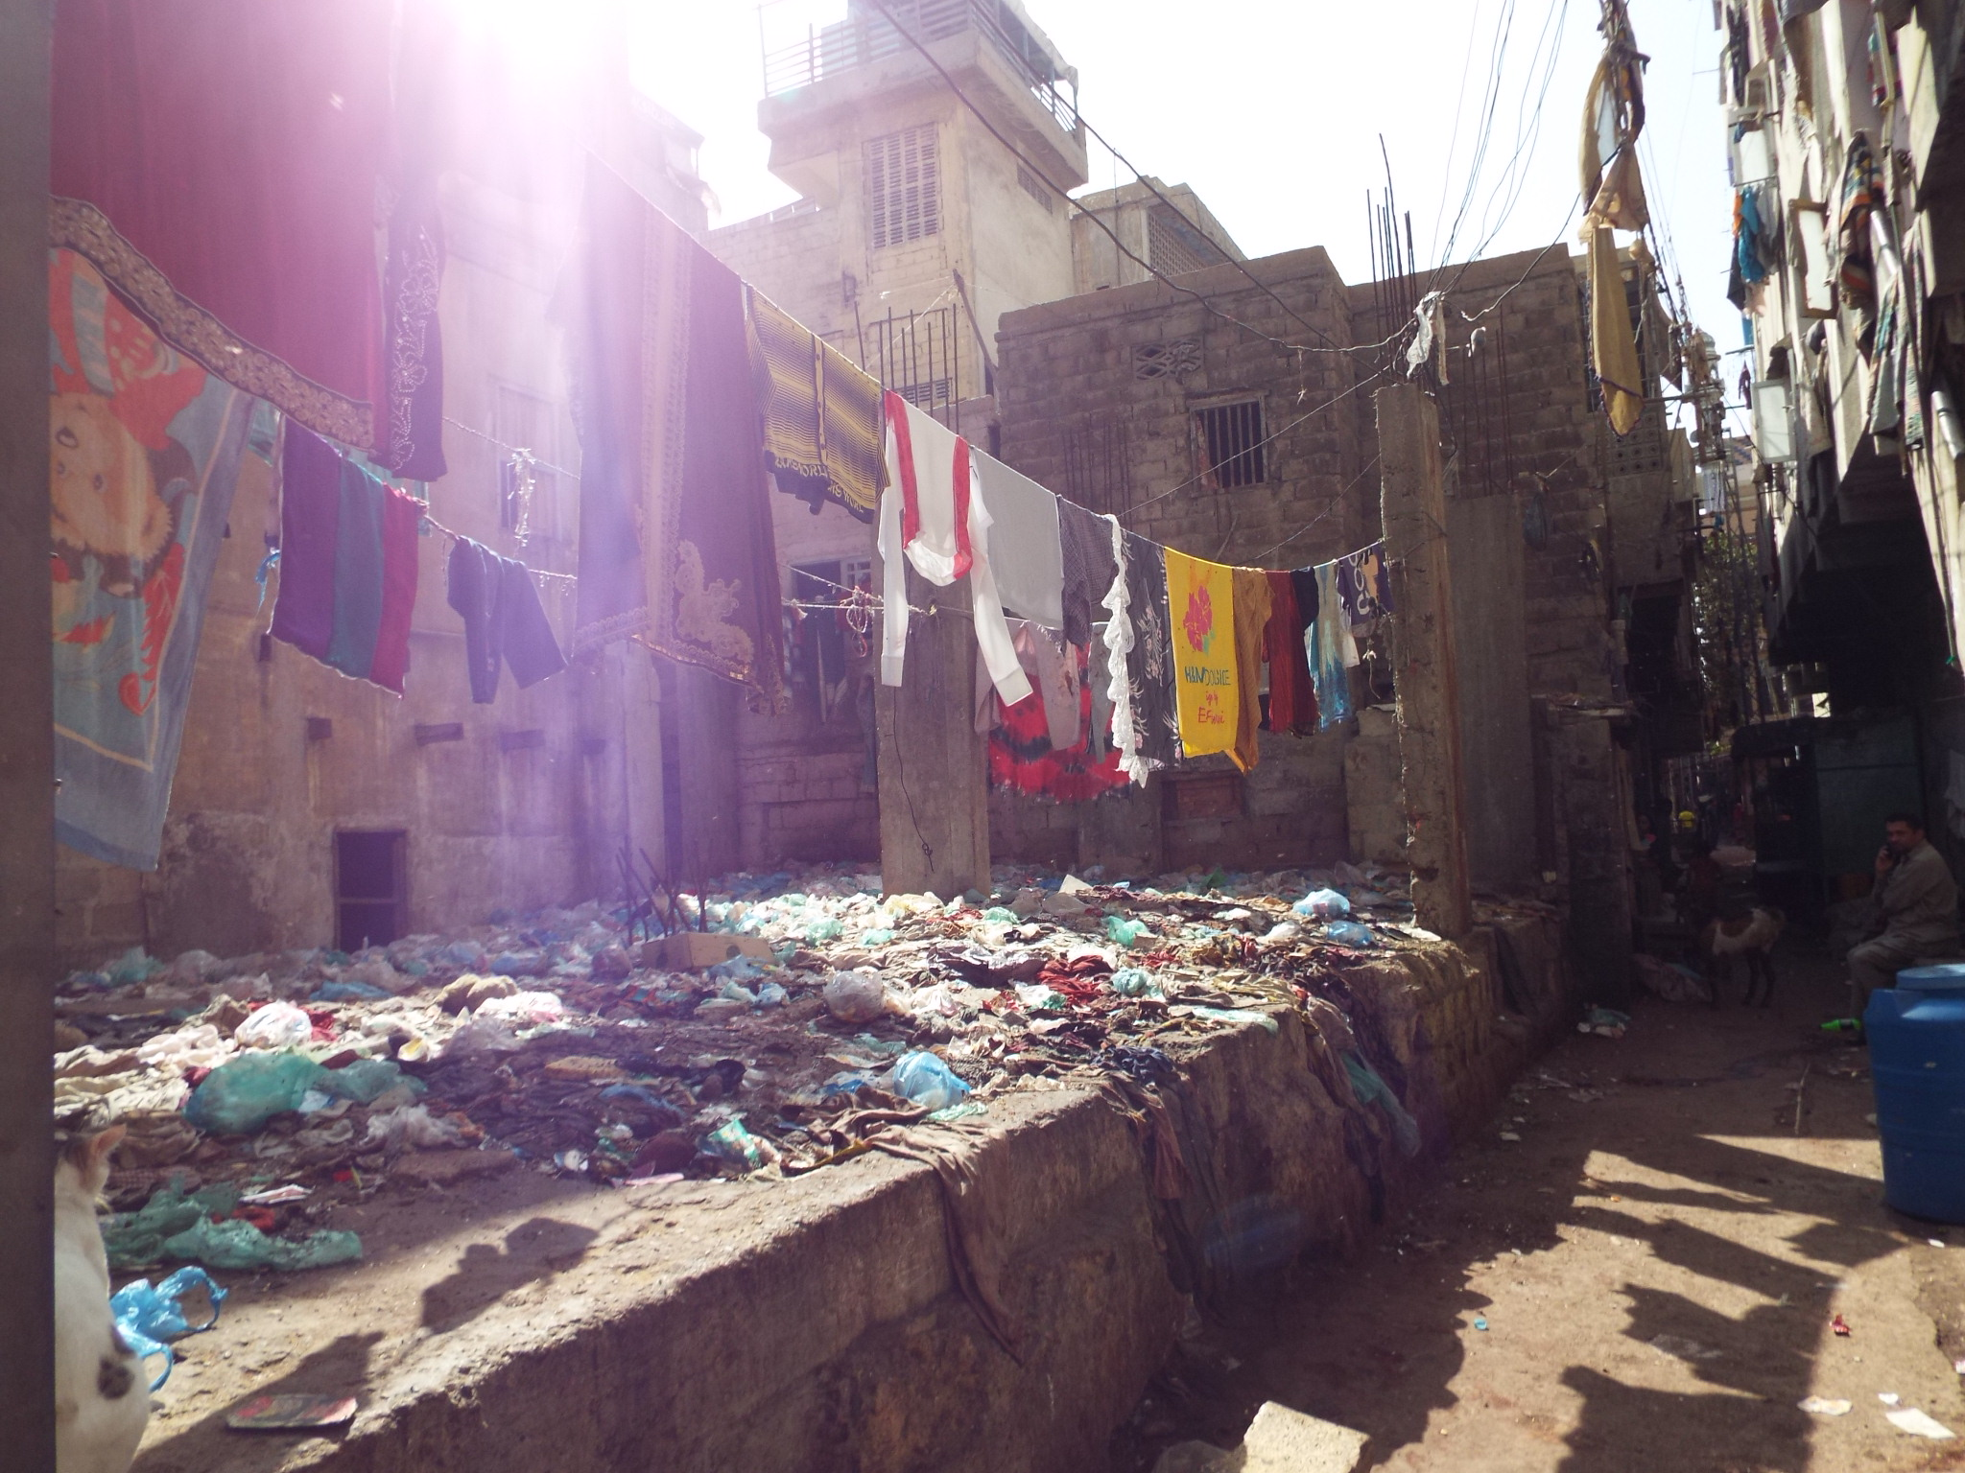
Out from the state level
Urban/rural differences
This analysis showed that 31% of women in Pakistan were employed in the last 12 months. This figure is higher for rural women (52%) compared with urban (21.9).
In rural areas, women were less likely to work the more they agreed with norms justifying wife beating, but in urban areas this trend is reversed.
The unadjusted odds ratios show that rural women are significantly more likely to experience all forms of violence ever, or in the last year.
Challenging social norms

Slide 8
Intersectional Analysis – Pulling out the Differences

Slide 9
Intersectional Analysis – Pulling out the Differences
While most women did not identify a clear link between employment and an increase or decrease the in the occurrence of domestic violence, women’s involvement in paid employment came with a combination of costs and benefits.
Poor women experience the most acute violence.
If given the choice, poor women would not work but wealthier women would maintain their careers.
Professional women experienced less violence at home but had other pressures in particular psychological.

Slide 10
Out from the national level – Recommendations
Promoting local women’s organisation and building capacity at this level to challenge VAW and advocate for survivors is important and should extend to supporting professional women.
The working conditions of poor women need to be addressed as a matter of urgency.
Work-based harassment policies and procedures need to be reviewed across sectors and evidence of good practice identified and encouraged more strongly. When laws are embedded, women report safer working conditions.
Women-only transport schemes are clearly needed.
Structural national issues remain a barrier with a largely unresponsive criminal justice system.

