Slide 1
Tackling VAWG in times of conflict: responding to youth voices from South Sudan
Presenter Name: Date:

Slide 2
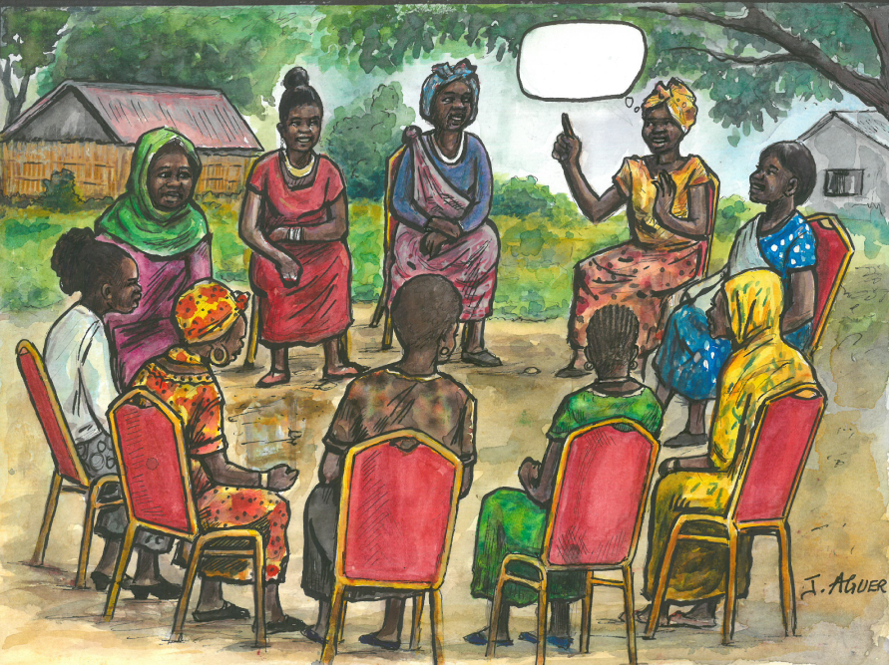
Overview
Objective - to capture the views and experiences of young people; the impact of violence and conflict, exploring:
The effect and manifestation of displacement in different contexts, and
How people’s sense of personal and community security are affected.
Mixed methods approach combining a qualitative tool called “Story Circles” (both male and female participants) with a quantitative survey (respondents are young women and girls aged 15+).

Slide 3
Top Level Survey Findings
A total of 2,500 women were interviewed across two sites: 700 in Nimule (Magwi) and 1,800 in Yei.
Conflict has severely affected the respondents over their lifetimes. In Magwi, 85.5% of women reported having been displaced at some point in their lives, while in Yei, the figure was higher, at 92.1%.
Non Partner Sexual Violence - Across the two sites, more than half (55.1% (higher than the 2015-16 survey¹)) of women who responded stated they had experienced some form of sexual violence during their lifetimes.
In Nimule, the most commonly reported form that sexual violence took was rape or attempted rape, with 23% of respondents citing this, while in Yei, sexual exploitation was most reported by 27.3% of respondents.
¹Ellsberg M, Ovince J, Murphy M, Blackwell A, Reddy D, Stennes J, et al. (2020) No safe place: Prevalence and correlates of violence against conflict-affected women and girls in South Sudan. PLoS ONE 15(10): e0237965. Data collection took place in 2015 and 2016.

Slide 4
Story Circles: comparison (Nimule & Yei)
Nimule | Yei
Participants focused on land grabbing and inter-ethnic conflicts in the Story Circles, with soldiers figuring prominently as perpetrators of violence Participant stories made clear associations between recurring phases of displacement and the inter-generational impact Many participants in the Nimule Story Circles were from the area or had been residents for a long time | Participants were largely focused on the current conflict in South Sudan between rebel groups and the government, rather than all phases of conflict Most of the participants in the Yei Story Circles were living in IDP camps and did not feel as they had a home

Slide 5
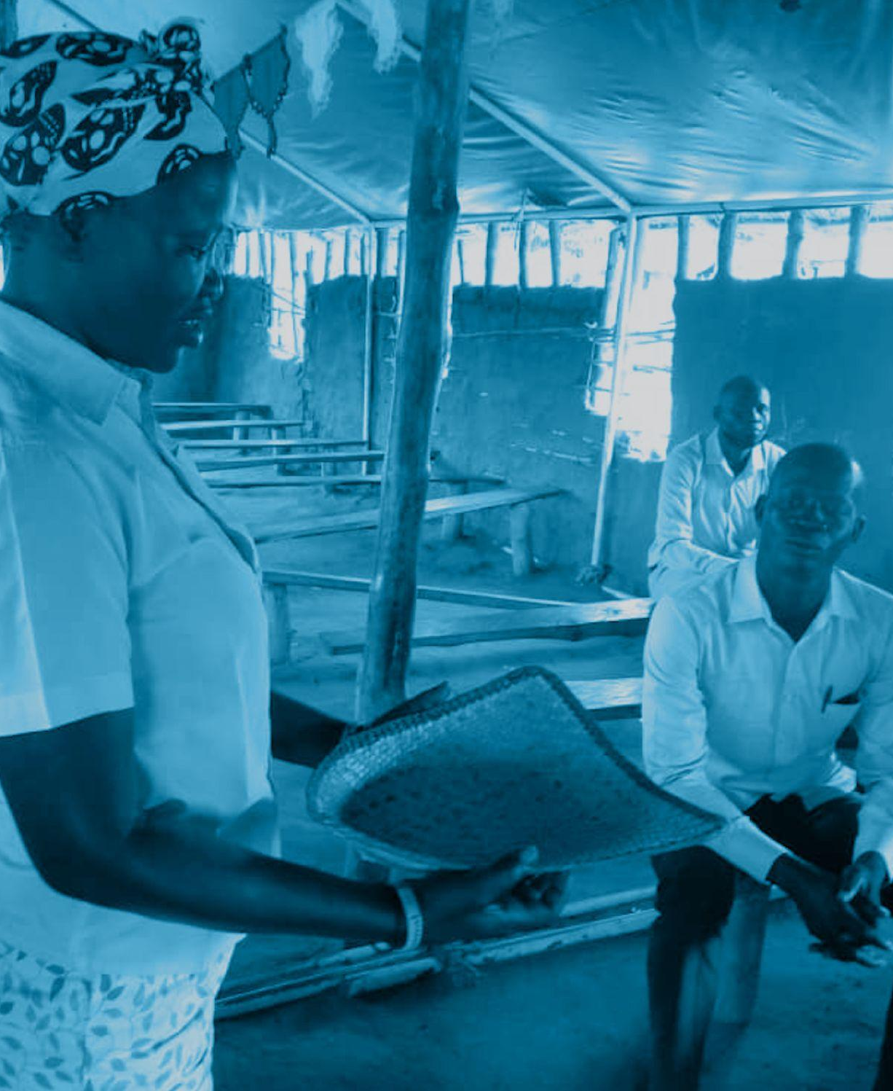
Violence against women and girls
The number of times that women had experienced sexual violence differed in the two locations, with over half of women in Nimule (59.3%) reporting having experienced it many times compared to only 22.1% in Yei reporting the same. In Yei, most respondents (77.9%) reported experiencing sexual violence once or a few times.
More than half, 54.2% (59.0% in Magwi and 52.4% in Yei) of women who reported IPV, experienced the most severe forms of violence (defined as being hit, kicked or dragged, choked or burnt, or threatened with a knife or gun). Moderate violence (defined as slapped or something thrown at, pushed or shoved) was experienced more overall, with rates of 68.4% in Magwi, 66.0% in Yei and 66.7% overall.

Slide 6
Violence against women and girls
Lifetime prevalence of physical and/or IPV was high across both sites, with 77.7% of respondents in Nimule reporting and 73.8% in Yei. In both sites, a high proportion of respondents reported having experienced IPV during the last twelve months, with 61.1% reporting physical violence and 83.3% reporting sexual violence. High levels of control by men over all aspects of their wives’ lives was reported at both sites.
In Yei, the most reported (75%) form of the control was a husband getting jealous or angry if his wife talked to another man, while in Nimule, the most reported form that control took was a husband insisting on knowing where his wife was at all times (75%).

Slide 7
Normalisation of violence
Respondents were asked whether they agreed or disagreed with a series of statements reflecting common gender-related social norms.
In Yei, respondents were more likely to endorse restrictive gender norms, with 84.5% agreeing that it is a wife’s obligation to have sex with her husband whenever he wants, compared to 78.3% in Nimule. Similarly, 81.5% of respondents agreed that a wife should obey her husband even if she disagrees, compared to 77.8% in Nimule and 80.5% stating that a woman should tolerate violence to keep her family together, compared to 76% in Nimule.
With respect to attitudes regarding responsibility for rape, more women in Yei (69.5%) felt that if a woman is raped, she has usually done something careless to put herself in that situation, compared to 48.7% of respondents in Nimule agreeing with this statement.
Almost 95% of women in Yei felt that a man is justified in beating his wife if she neglects the children, with the second most cited justification (85.5%) being if a woman goes out without telling her husband. These figures are compared to 63% and 51% in Nimule for the same justifications for physical violence.

Slide 8
Story Circles give deeper insights to the survey findings
Many stories of displacement in the Nimule pilot reveal inter-ethnic and inter-communal conflicts and conflicts over land grabbing. Gendered conflicts (especially around marriage but also raising children) are intertwined in the broader narratives of displacement, dispossession and interethnic/intercommunal violence. Blame, resentment and distrust are commonly expressed toward other ethnic groups for violence (especially militarized violence exerted on communities in Nimule). Youth in Nimule often had experiences of negotiating multiple displacements. Some speakers revealed the constructed nature of “home” in that they positioned themselves (through marriage and/or migration) as “in-between” ethnicities / communities or as having assimilated to new community

Slide 9
Story Circles: Findings (Session III: Conflict and Violence)
Multiple and intersecting forms of violence are present in the stories (interpersonal and domestic, cultural, communal, physical, psychological and emotional, economic, etc.) “Negative cultural norms” are sometimes identified as the source of violent behaviour. In Nimule, Dinka soldiers are identified as the dominant perpetrators of violence through coercion, land grabbing, abduction and early marriage of young women, mistreatment of wives. There is less discussion of domestic violence as part of everyday life. Victims of violence include young women (by both strangers and family members) and sometimes young men who are victimized and wrongfully accused.

Slide 10
Story Circles: Findings (Session III: Conflict and Violence)
Dominant coping mechanisms include submissiveness, staying silent and relying on God / religion for ultimate justice; applying religious discourse to claim justice and transform bad norms; nostalgia for ”good cultural norms”; attempting to seek justice at police or courts; advocacy and speaking out through NGOs and media. Government is criticized by many for inaction and retreating from responsibility. Some people have adopted “NGO-speak” as part of their vocabulary and world view, but there is also awareness that this is happening (“my husband has beaten me bad”).

Slide 11
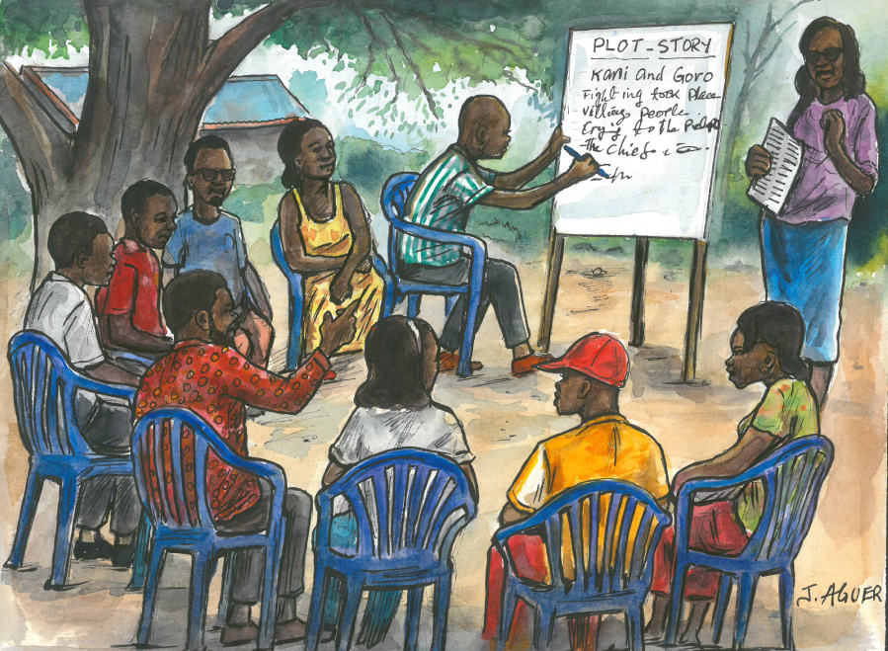
Recommendations
The role of culture and associated cultural norms need to be recognised for their importance in the perpetuation of violence across generations.
Any attempt to change marital norms must be approached sensitively as there is potential for violent backlash.
The government needs to address issues of violence and the impact of conflict and take responsibility by engaging pro-actively in policy formulation, legislation etc.
The recognition that violence has affected all ethnic groups and not one more than the other needs to be emphasized.
The frequency and incidence of domestic violence needs to be addressed separately from trauma more closely correlated with war. The normalisation of domestic violence is not recognised if consistently discussed in the context of conflict-related trauma.
It is imperative that young people are actively engaged if the tolerance and the prevalence of violence are to decrease.

